Slide 1
덴버 개발 제안서
- PA Controller -
2011. 3. 16
RF-comm

Slide 2
PA Controller Block Diagram
Audio Amplifier Board
Audio File
Memory
PA
Controller
Power AMP
Channel 1
Interior Speaker
Channel 1
Audio File CNCS
(via USB)
Automatic
Broadcasting
Player
Matching
Transformer
Recording
Control
VOIP Audio
Interior SPK
Volume Control
(Interior Channels)
Power AMP
Channel 2
Interior Speaker
Channel 2
RS-485 CL
Matching
Transformer
Cab On
I²C (Inter-Integrated Circuit)
Exterior SPK
Volume Control
(Left Channel)
Door
I 2C
Conductor Audio
Exterior SPK
Volume Control
(Right Channel)
Power AMP
Channel 3
Exterior Speaker
Channel 1
Left Side
Intercom Audio
Matching
Transformer
Driver Audio
ANS Controller
MCU
Ether net
Ether net VoIP
Control UNIT
Exterior Speaker
Channel 2
Right Side
Power AMP
Channel 4
Matching
Transformer
Line Control
TRF
TRF
Power
Module
PA audio TL
Intercom TL
Ether net
TL
ANS
Microphone
ANS
Microphone
DC37.5V
Trainlines
PA Controller Block Diagram-R01 - 20110316ppt

Slide 3
Denver DPO Block Diagram
Volume Control Knob
AMP
AUDIO EXPANDER
Solid State Switching Circuitry
L.P.F
ALC
Transformer
DPO Audio
L.P.F
ALC
Transformer
CPO Audio
AMP
AUDIO COMPANDOR
L.P.F
ALC
Transformer
PEI Audio
Internal
Microphone
L.P.F
ALC
Transformer
VOIP Audio
Lapel Mic. Jack
CAB ON
Communication
BUZZER
& Circuitry
Tone
DRIVER
Dual Tone Audio
Audio Controller
Transformer
Push Button
BUZZER
Logic
Controller
Tone
Filter
Tone
Generator
DC37.5V
Push Button
SPEAKER
Digital
Detection
Digital
Control
INT
EXT
BOTH
Live Signal
Address Signal
To PAC
INTERCOM
Regulator
IC
PEI
CANCEL
DC37.5V
Power
Module
(DPO) Block Diagram-R01 - 20110316.ppt

Slide 4
Denver CPO Block Diagram
Volume Control Knob
AMP
AUDIO EXPANDER
Solid State Switching Circuitry
DPO Audio
L.P.F
ALC
Transformer
L.P.F
ALC
Transformer
CPO Audio
AMP
AUDIO COMPANDOR
L.P.F
ALC
Transformer
PEI Audio
Microphone
Audio Controller
Tone
DRIVER
Transformer
Dual Tone Audio
Train Car
Door Panel
KEY IN
Push Button
Logic
Controller
Tone
Filter
Tone
Generator
SPEAKER
Digital
Detection
Digital
Control
INT
EXT
BOTH
Live Signal
Address Signal
INTERCOM
Regulator
To PAC
IC
PEI
CANCEL
DC37.5V
Power
Module
(CPO) Block Diagram-R01 - 20110316.ppt

Slide 5
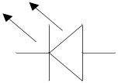
Denver PEI Block Diagram
AMP
AUDIO EXPANDER
L.P.F
ALC
Transformer
PEI Audio
AMP
AUDIO COMPANDOR
Tone
DRIVER
Transformer
Dual Tone Audio
STATUS
LAMPS
AUDIO S/W
Tone
Filter
Tone
Generator
POWER
Digital
Detection
Digital
Control
Logic
Controller
TALK
LISTEN
WAIT
Push Button
Live Signal
Address Signal
To PAC
Regulator
CALL
DC37.5V
Power
Module
(PEI) Block Diagram-R01 - 20110316ppt

Slide 6
Denver Intercom
Denver Dual Tone Multiple Frequency
D
P
O
CRA
PEI
PEI
PEI
CRB
D
P
O
D
P
O
CRA
PEI
PEI
PEI
CRB
D
P
O
D
P
O
CRA
PEI
PEI
PEI
CRB
D
P
O
DTMF
TONE
CPO
CPO
DTMF
TONE
DTMF
TONE
CPO
CPO
DTMF
TONE
DTMF
TONE
CPO
CPO
DTMF
TONE
Dual Tone Multiple Frequency Signal Intercom
1) Dual Tone Multiple Frequency 신호는 음성대역내의 4개의 주파수로 구성된 서로 다른 그룹으로부터 각각 하나씩 선택 되어 사용 한다.
2) Dual Tone Multiple Frequency 신호는 높은 주파수 4개 낮은 주파수 4개를 사용 하며, 16개의 I/O를 제어 할 수 있다.
3) Tone 신호는 가청 주파수를 사용 하여 케이블 임피던스 영향이 적다.
4) Tone 신호를 및 Address Signal 사용 하여 PEI CALL 위치를 확인 한다.
5) 오디오 라인과 Tone 라인 불리 하여 통화 시 이미지 주파수 발생 방지.
EXPANDER (입력 오디오 신호 중에서 큰 신호는 일정 크기로 변환 하고, 작은 신호는 큰 신호로 변환하여 일정한 신호를 유지 한다 )
COMPANDOR ( 출력 오디오 신호 중에서 큰 신호는 일정한 크기로 변환 하고, 작은 신호는 더 작은 신호로 변환 하여 잡음을 제거 한다 )
Dual Tone Multiple Frequency Diagram-R01 - 20110308.ppt

Slide 7
Recording Control Block Diagram
Recording
Control
Intercom Audio
TRF
COMPRESSION
DRIVER
(Analog)
Audio File
PA Audio
TRF
COMPRESSION
DRIVER
(Analog)
PEI Audio
TRF
COMPRESSION
DRIVER
(Analog)
Ether net
Intercom Audio ( 인터폰 통화 입력 오디오 라인 )
PA Audio (스피커 방송 입력 오디오 라인 )
PEI Audio ( 비상 인터폰 입력 오디오 라인 )
TRF ( Transformer )
COMPRESSION ( 입력 오디오 신호를 압축하여 출력을 일정한 크기로 변환 하고, S/N 을 개선 한다 )
DRIVER Analog ( 오디오 신호를 출력으로 전달 하고, 입력 신호를 검출 하여 녹음을 제어 한다 )
Recording Control Block Diagram-R01 - 201103016ppt

Slide 8
Ether net VoIP Control
CODEC
DSP
CODEC
Audio
ARM
GPIO
IO Control
FLASH
MAC
LAN
Ether
SDRAM
Ether net VoIP Control
As CPU platform, Core (Hardware IP) attached bare necessity peripheral to implement OS is built in to ARM7CPU
8KB cache memory .
CODEC Interface
Ether net MAC Controller
VoIP Codec DSP
Analogue input/output 3 chain, digital input/output 2 chain are built-in for voice interface of Intercom
Speech G.729.A (8 kbps), G.711 (64kbps) selectable (voice 1 channel for processing)
Ether net VoIP Control Block Diagram-R01 - 20110228.ppt

Slide 9
RS-485 DPO Block Diagram
Volume Control Knob
AMP
AUDIO EXPANDER
Solid State Switching Circuitry
L.P.F
ALC
Transformer
DPO Audio
L.P.F
ALC
Transformer
CPO Audio
AMP
AUDIO COMPANDOR
L.P.F
ALC
Transformer
PEI Audio
Internal
Microphone
L.P.F
ALC
Transformer
VOIP Audio
Lapel Mic. Jack
CAB ON
Communication
BUZZER
& Circuitry
Audio Controller
Push Button
BUZZER
Logic
Controller
DC37.5V
Push Button
RS-485
SPEAKER
RS-485
INT
EXT
BOTH
INTERCOM
IC
PEI
CANCEL
DC37.5V
Power
Module
(DPO) Block Diagram-R01 - 20110316.ppt

Slide 10
RS-485 CPO Block Diagram
Volume Control Knob
AMP
AUDIO EXPANDER
Solid State Switching Circuitry
DPO Audio
L.P.F
ALC
Transformer
L.P.F
ALC
Transformer
CPO Audio
AMP
AUDIO COMPANDOR
L.P.F
ALC
Transformer
PEI Audio
Microphone
Train Car
Door Panel
Audio Controller
KEY IN
Push Button
Logic
Controller
RS-485
SPEAKER
RS-485
INT
EXT
BOTH
INTERCOM
IC
PEI
CANCEL
DC37.5V
Power
Module
(CPO) Block Diagram-R01 - 20110316.ppt

Slide 11
RS-485 PEI Block Diagram
AMP
AUDIO EXPANDER
L.P.F
ALC
Transformer
PEI Audio
RS-485
RS-485
AMP
AUDIO COMPANDOR
STATUS
LAMPS
AUDIO S/W
POWER
Logic
Controller
TALK
LISTEN
WAIT
Push Button
CALL
DC37.5V
Power
Module
(PEI) Block Diagram-R01 - 20110308.ppt

Slide 12
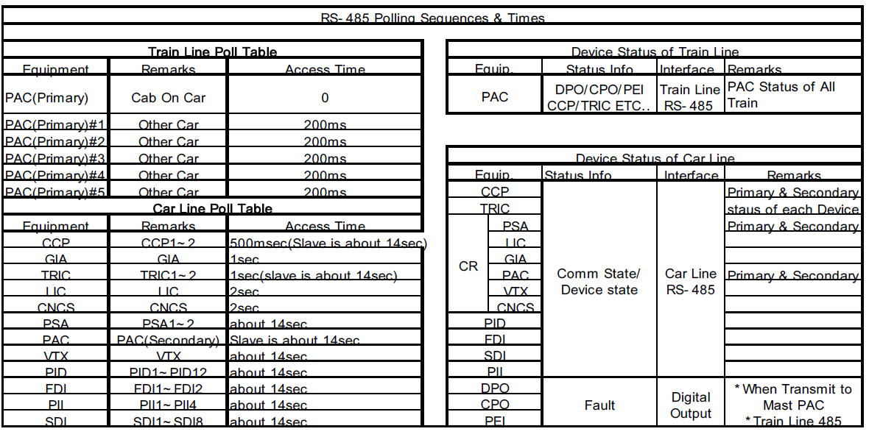
RS-485 Polling Table
SEPTA RS-485 Polling Table
D
P
O
CRA
PEI
PEI
PEI
CRB
D
P
O
D
P
O
CRA
PEI
PEI
PEI
CRB
D
P
O
D
P
O
CRA
PEI
PEI
PEI
CRB
D
P
O
Ether net
CPO
RS485
CPO
Ether net
Ether net
CPO
RS485
CPO
Ether net
Ether net
CPO
RS485
CPO
Ether net
RS-485 Intercom
1) RS-485 통신 시간 1~2SEC Polling 시간에 따른 가변적 연결 문제. ( DPO에서 PEI 통화로 구성 시 마이크 스피커 절환 문제)
2) RS-485 통신 이상 시 통화로 구성 안됨. (RS-485 연결 문제시 개별 및 전체 연결 안됨)
RS-485 Polling Table Diagram-R01 - 20110308.ppt

Slide 13

Volume Control Knob
TRF : Transformer
IC Audio (PAC Car Line)
AMP
Solid State Switching Circuitry
Low pass filter
TRF
Low pass filter
TRF
PEI Audio (PAC Car Line)
Internal Microphone
Low pass filter
TRF
PA Audio (PAC Car Line)
AMP
AGC
TRF
To TRIC Audio
CAB
Dashboard
To TRIC PTT
PWM Lamp
Test S/W
RADIO
BUTTON
Lapel Mic. Jack
Detect Signal
1. CANCEL
2. PEI
3. INTERCOM
4. BOTH
5. EXT_SPK
6. INT_SPK
7. CALL
8. PEI_TALK
Train Radio
Circuit Breaker
(Isolated Power)
TRF
TRF
TRF : Transformer
CHIME
BPF : Band Pass Filter
(24KHz~45KHz)
BPF
BPF
Driver
Part
Logic
Part
Frequency
to
Signal
(Two Modules)
STATUS
LAMPS
Signal To Frequency
(24KHz~45KHz)
PWM Signal
36KHz
40KHz
45KHz
Signal Generation
1. CANCEL
2. PEI
3. INTERCOM
4. BOTH
5. EXT_SPK
6. INT_SPK
8. PEI_TALK
Push Button(s)
24KHz
1
2
3
INT_SPK
Communication
BUZZER
& Circuitry
EXT_SPK
28KHz
4
5
6
BOTH
INT
EXT
BOTH
INTERCOM
Driver
Part 2
Push Button
PEI
IC
PEI
CNCL
32KHz
7
8
9
BUZZER
CANCEL
37.5V
Crystal (90.72 MHz)
37.5V
Power
Supply
24V
Regulator
12V
Regulator
Live Signal
24V Level
5V
Driver
To PAC
Address Signal
24V Level
To PAC
(DPO) Block Diagram-R09- 20080820.ppt

Slide 14
TRF : Transformer
IC Audio (PAC Car Line)
AMP
Solid State Switching Circuitry
Low pass filter
TRF
Low pass filter
TRF
PEI Audio (PAC Car Line)
Low pass filter
TRF
PA Audio (PAC Car Line)
AMP
AGC
Internal Microphone
Train Car
Door Panel
KEY IN
Detect Signal
1. CANCEL
2. PEI
3. INTERCOM
4. BOTH
5. EXT_SPK
6. INT_SPK
7. CALL
8. PEI_TALK
TRF
TRF
TRF : Transformer
BPF
BPF
BPF : Band Pass Filter
(24KHz~45KHz)
Driver
Part
Logic
Part
Frequency
to
Signal
(Two Modules)
STATUS
LAMPS
Signal To Frequency
(24KHz~45KHz)
36KHz
40KHz
45KHz
Signal Generation
1. CANCEL
2. PEI
3. INTERCOM
4. BOTH
5. EXT_SPK
6. INT_SPK
8. PEI_TALK
Push Button(s)
24KHz
1
2
3
INT_SPK
EXT_SPK
28KHz
4
5
6
BOTH
INT
EXT
BOTH
INTERCOM
Driver
Part 2
PEI
IC
PEI
CNCL
32KHz
7
8
9
CANCEL
Crystal (90.72 MHz)
37.5V
Power
Supply
24V
Regulator
12V
Regulator
Live Signal
24V Level
5V
Driver
To PAC
Mute Signal
24V Level
To Speaker
(CPO) Block Diagram-R05- 20080820.ppt
Address Signal
24V Level
To PAC

Slide 15

AMP
Low Pass Filter
Transformer
PEI Audio (PAC Car Line)
AMP
AGC
R1
R2
Transformer
Band Pass Filter
Driver
Part 1
Logic
Part
Frequency
to
Signal
STATUS
LAMPS
Detect Signal
1. CANCEL
2. PEI
8. BUSY
Push Button
Driver
Part 2
Address Signal
24V Level
CALL
To PAC
CALL SIGNAL
37.5V
Live Signal
24V Level
Power
Supply
24V
Regulator
12V
Regulator
5V
Driver
To PAC
(PEI) Block Diagram-R03 - 20080622.ppt

Slide 16
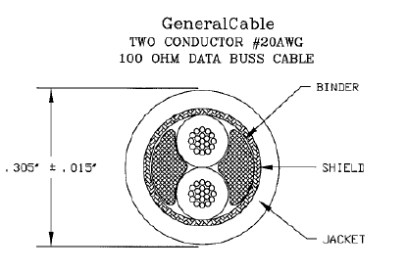
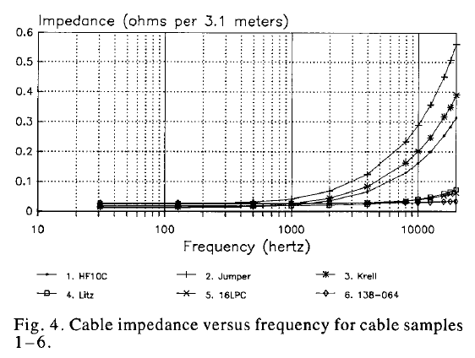
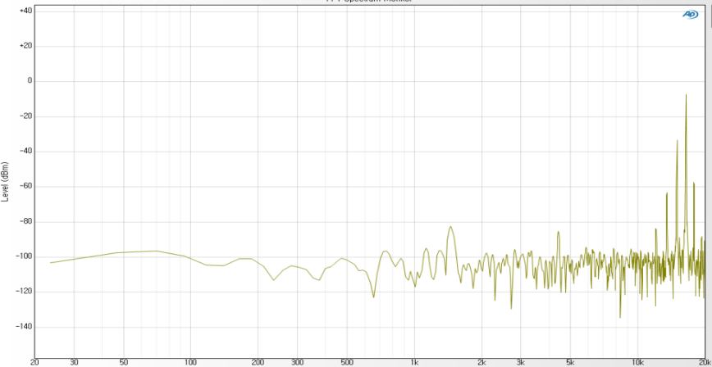
SEPTA Intercom
SEPTA HI-TONE DTMF
D
P
O
CRA
PEI
PEI
PEI
CRB
D
P
O
D
P
O
CRA
PEI
PEI
PEI
CRB
D
P
O
D
P
O
CRA
PEI
PEI
PEI
CRB
D
P
O
Hi
TONE
CPO
CPO
Hi
TONE
Hi
TONE
CPO
CPO
Hi
TONE
Hi
TONE
CPO
CPO
Hi
TONE
)
)
Cable Electrical
Cable Electrical Frequency
이미지 주파수
Dual Tone Multiple Frequency Signal Intercom (Hi Frequency )
1) Dual Tone Multiple Frequency 신호 주파수 16KHz ~ 47KHz 사용.
2) 신호 톤 발생시 이미지 주파수 발생 하여 통화 시 톤 소리 스피커 방송..
3) Tone 신호는 높은 주파수를 사용 하여 케이블 임피던스 영향이 많다.
4) 하나의 케이블에 오디오 신호와 톤 신호가 중첩 되어 통화 시 잡음 발생.
RS-485 Polling Table Diagram-R01 - 20110308.ppt

